Slide 1
Analysis of Energy Use, CO₂ Emissions, and Air Quality
Group Members: Ahmed, Ben, Bryson, John, Sristy

Slide 2
Datasets Used
Annual CO₂ Emissions by Country (Our World in Data)
Monthly Electricity Production by Country (International Energy Agency)
Air Pollution by Country (World Health Organization)
Population by country (Worldbank.org)

Slide 3
Renewables VS Non-Renewables
Ahmed Naeem

Slide 4

Renewable Energy Sources
Solar energy
Wind energy
Hydro energy
Tidal energy
Geothermal energy
Biomass energy

Slide 5
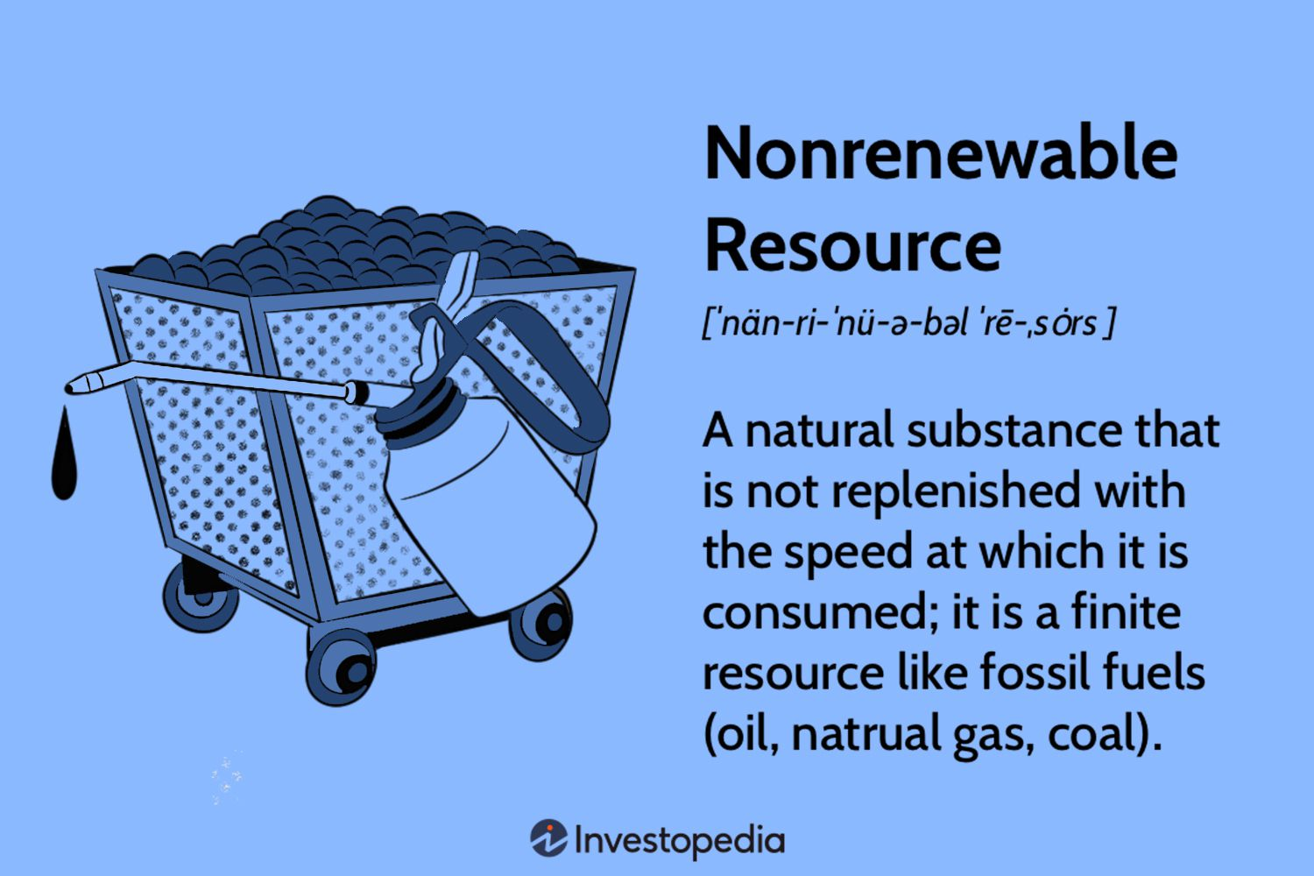
Non-Renewable Energy Sources
Petroleum
Natural gas
Coal
Nuclear energy

Slide 6
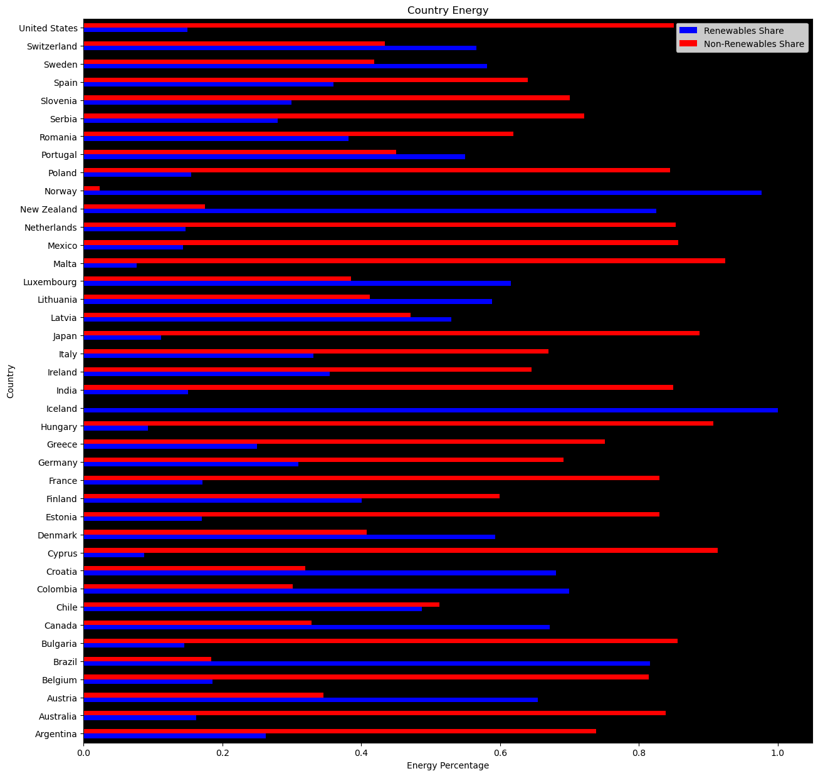

Slide 7
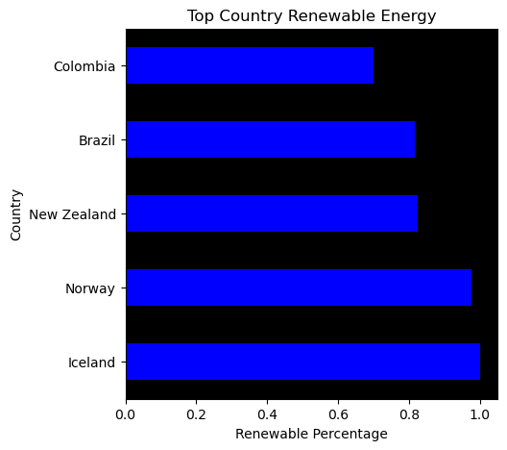
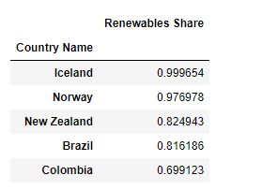
j

Slide 8
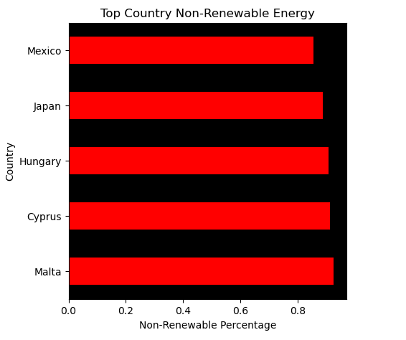
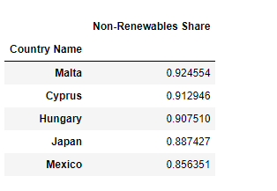

j

Slide 9
Why are Non-Renewables used more often?
Policy
Environmental Legislation
Market
Coal is cheap and can be sourced domestically
Together these influence country energy choices
https://kleinmanenergy.upenn.edu/research/publications/the-long-goodbye-why-some-nations-cant-kick-the-coal-habit/

Slide 10
Particulate Matter VS Respiratory Death Rate
Ahmed Naeem

Slide 11
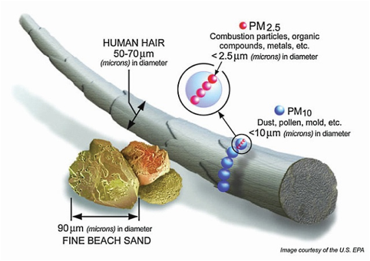
What is Particulate Matter?
A product of the following:
Emissions
Burning wood, swirls of dirt that form when the wind blows
Larger particles come mostly from the soil. Smaller particles come from burning of fossil fuels, like gasoline in cars, diesel in trucks and coal used by power plants
Measured in microns. 25,000 microns in 1 inch
https://scdhec.gov/environment/your-air/most-common-air-pollutants/particulate-matter/what-particulate-matter#:~:text=Particulate%20matter%20(PM)%20is%20made,vehicles%20and%20industrial%20plant%20smokestacks)

Slide 12
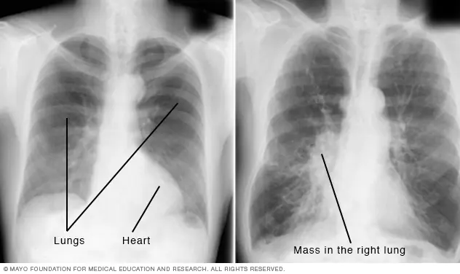
Respiratory Diseases
Pneumonia, lung cancer and chronic obstructive pulmonary disease (COPD), remain a leading cause of disability and death worldwide.
https://www.ncbi.nlm.nih.gov/pmc/articles/PMC8608323/

Slide 13
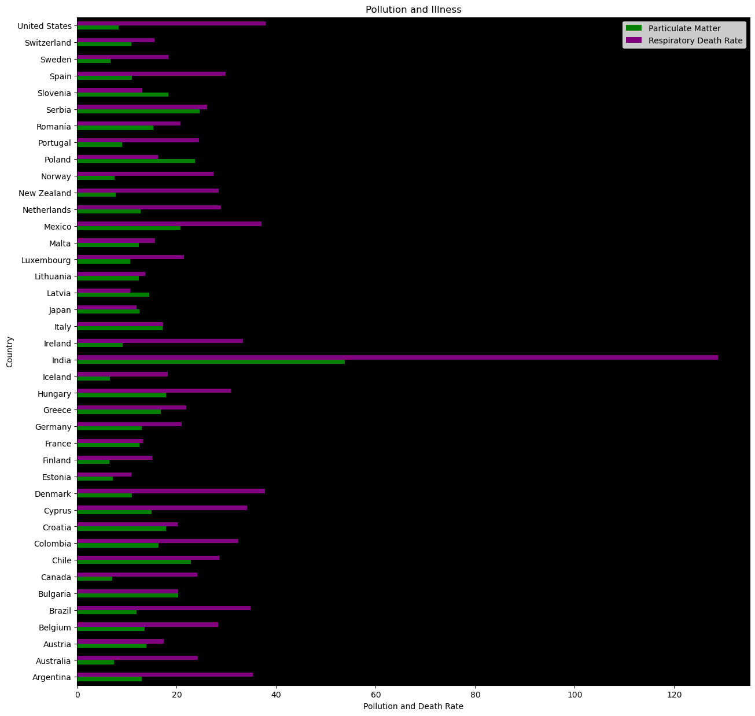
j

Slide 14
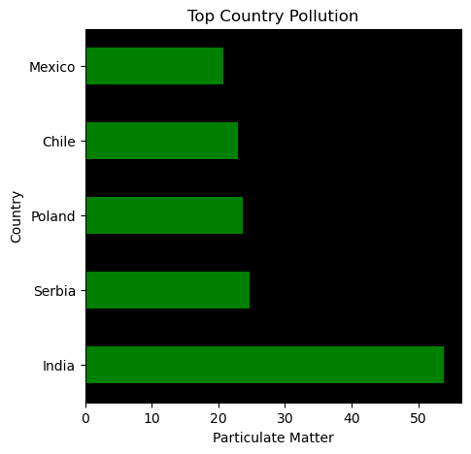
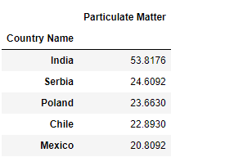
j

Slide 15
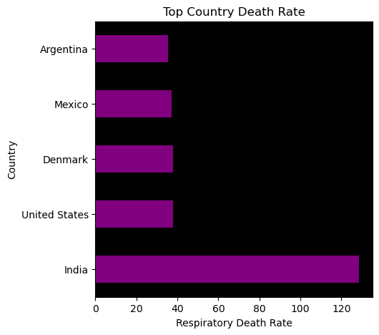
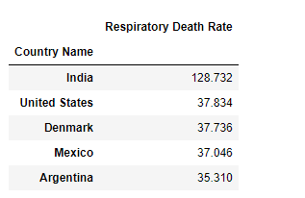
j

Slide 16
Statistical Analysis
T Statistic: -3.726758973266543
Negative value meaning high particulate matter = lower death rate
P value: 0.00036540618964292287
Significant correlation, rejects null hypothesis
R: 0.7232314334998892
Strong Linear Relationship
High particulate matter = high death rate

Slide 17
CO₂ Emissions by Energy Usage
Bryson Bosley

Slide 18
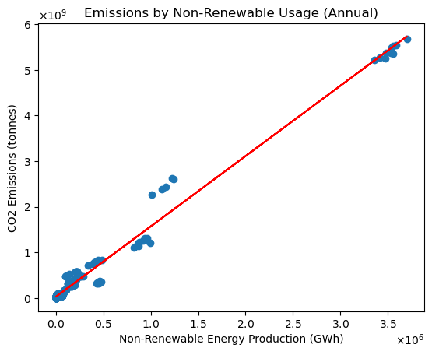
Emissions by Energy Use
Filtered to Non-Renewable Energy Sources
Data From 40 Countries
R-Value > .99
P-Value < 3x10⁻¹² (T-Test Derived)

Slide 19
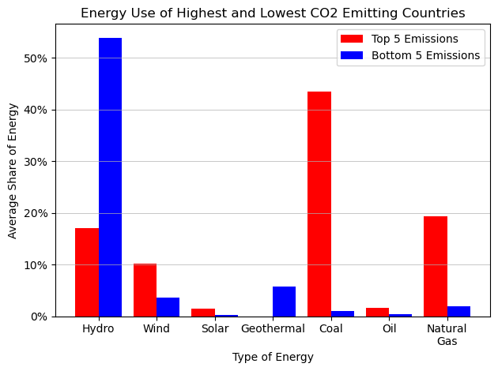
Share of Energy Production
Filtered to Top and Bottom 5 Countries by Annual Emissions
% Share of Each Type of Energy
Highest Emission Countries used
42% More Coal
17% More Natural Gas
36% Less Hydro
6% More Wind

Slide 20
Conclusions
Getting more of your energy from Renewable Sources helps lower CO₂ Emissions.
Higher Emission Countries use significantly more Coal & Natural Gas
Lower Emission Countries use significantly more Hydro
By encouraging the use of Renewable Sources of Energy, countries can dramatically lower their CO2 Emissions. By doing so, they can reach compliance with various Climate Standards, such as the United Nations 2015 Paris Agreement, Sustainable Development Goals, and potential future Climate Action Summit Standards.

Slide 21
Air Quality based on
Particulate Matters & CO2 Emission
Presented by
Sristy Pokhrel Acharya

Slide 22
Topics covered
Table representing top 1 and bottom 1 country based on Co2, Particulate matter and respiratory death rate .
Line plot for co2 emission and particulate matter.
Bar chart showing CO2 emitted by each country.
Scatter plot showing relationship between CO2 emission and particulate effects, with T- value, R value and P value.
Hypothesis under the study and testing
Results

Slide 23
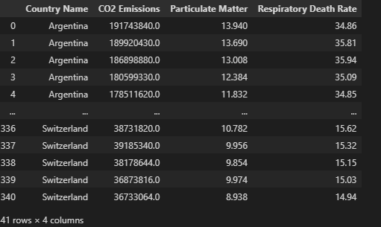
Air quality on the basis of Co2, Particulate matter and respiratory death rate
Among 40 countries

Slide 24
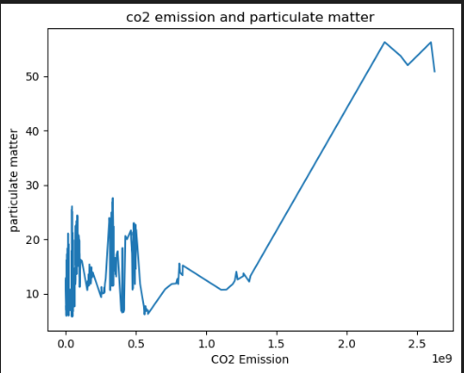
Line plot for co2 emission and particulate matter
The relationship between the two variables is not entirely linear.

Slide 25
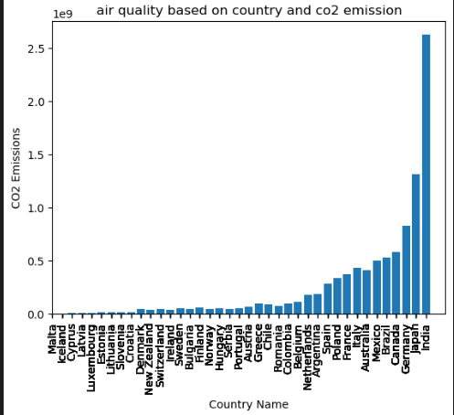
Bar Plot showing CO2 Emitted by each country

Slide 26
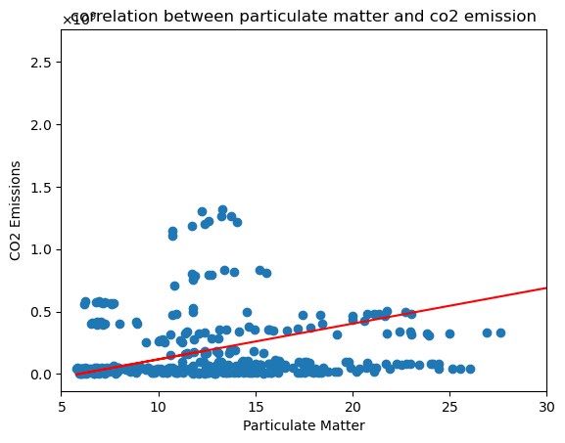
Scatter plot representing correlation between particulate matter and CO2 emission
The r-value is 0.53
Ttest_indResult(statistic=-10.62,
P Value= 1.74

Slide 27
Hypothesis
1. Null hypothesis – there is no statistical significance exists between co2 emission and particulate matter.
2. Alternative hypothesis – There is a significant relationship exists between co2 emission and particulate matter.

Slide 28
testings / results
As per T test and p test
The calculated t-statistic of -10.6208 provide evidence of a significant relationship between CO2 emission and particulate matter.
As the t-statistic had the largest negative value that represents stronger evidence against the null hypothesis. It shows there is a strong relationship between CO2 emissions and particulate matter.
P-value 1.7471 in the dataset indicates that it is highly unlikely to obtain a strong correlation alone and supports an alternative hypothesis.
As per R value
The R-value of -0.5298 shows the direction and strength of the correlations between the two variables.
A negative R-value shows the inverse relationship, where an increase in CO2 emissions is associated with lower particulate matter and vice versa.

Slide 29
Non-Renewable Energy Use and Air Quality Correlation
John Xuereb

Slide 30
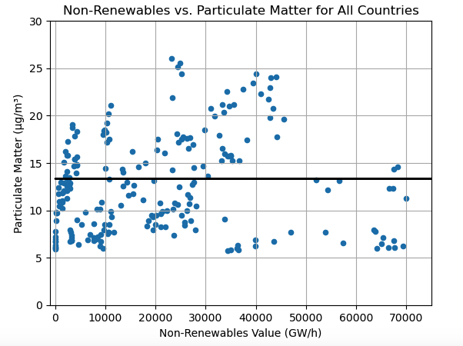
Statistics:
R-value = 0.03242948759261708
T-stat = 6.792548484422746
P-value = 4.7447643618601074e-11
Statistically strong, but weak positive correlation

Slide 31
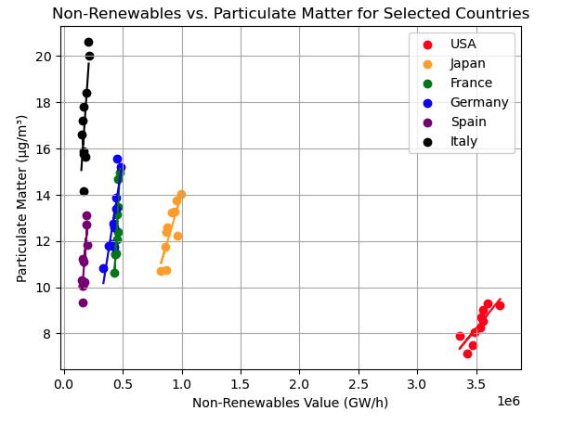
Every r-value was over .7
Every p-value was below .05
All selected countries showed a strong and statistically significant correlation

Slide 32

Insights
As expected, countries that use more non-renewables have more air pollution
America is quite the outlier (due to a number of factors)

Slide 33
Population and energy consumption
Presented by Benjamin Moran

Slide 34
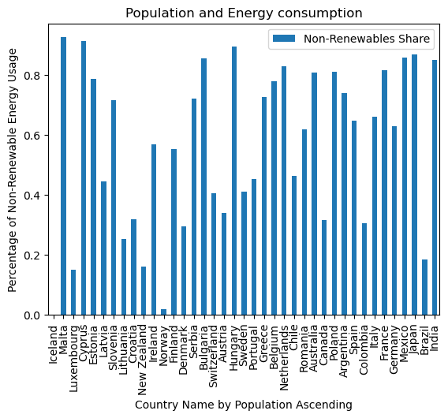
Country by ascending population
Percentage of Non-Renewable energy used
39 countries in set

Slide 35
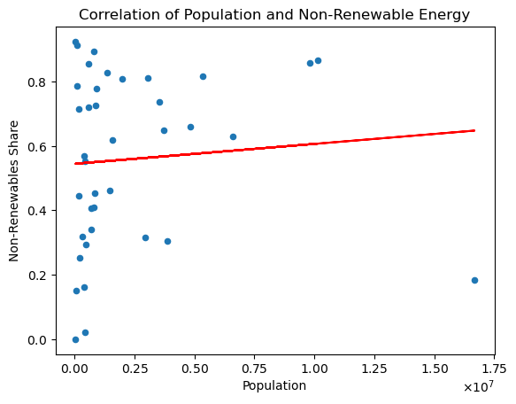
Scatter of non-renewable energy percentage by population per country
Shows there is a weak correlation with the R-Value being close to 0
t-statistic: 4.077075411415734
p-value: 5.5350395575308766e-05
The r-value is 0.07994508576506415

Slide 36
Conclusion
There is a weak correlation between population and non-renewable energy consumption per country
Might be another variable as to why countries use non-renewable or renewable energy sources other than population based.

